Slide 1
Why R?
Jeffrey Stanton
Syracuse University

Slide 2
What is R?
R is a statistics, data management, and graphics platform
R is open source, maintained and developed by a community of developers.
The R code repository, as well as compiled binaries (ready-to-install software) available at: http://cran.r-project.org
R comprises a core program plus 1000s of freely available add-in packages.

Slide 3
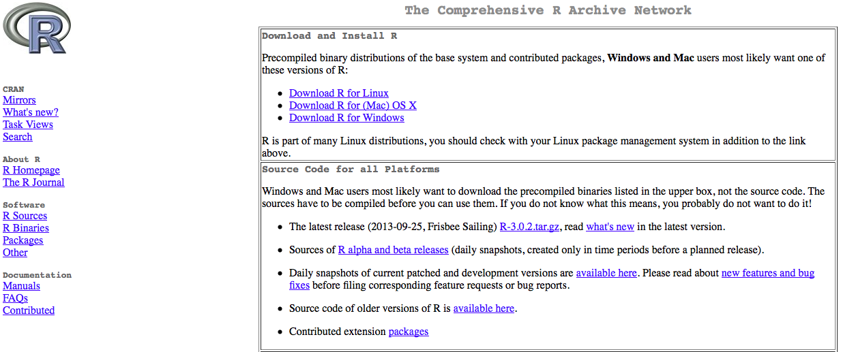
CRAN

Slide 4
So Why or Why Not R?
Most popular statistics software (other than R) and some of their audiences:
SPSS: Social Scientists
Stata: Social Scientists
Mathematica/Matlab: Engineers, mathematicians, computer scientists, and physicists
Python/NumPy: Computer scientists, web developers
SAS: Data intensive industries (e.g., financial services)
Excel: All types of organizations
R is more popular and used by a larger number of analysts than each of these

Slide 5
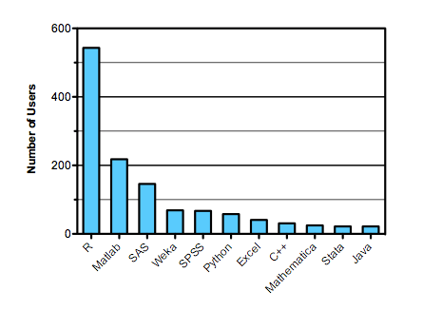
http://r4stats.com/articles/popularity/

Slide 6
But. . .
Statistics users like point and click
R is command line oriented; there are GUIs that can be loaded as add-on packages;
R-Studio is a Integrated Development Environment (IDE) for R, but more for code development than statistical analysis
R is free, but this also means that there is no formal support mechanism; large organizations often like to contract with a commercial provider

Slide 7
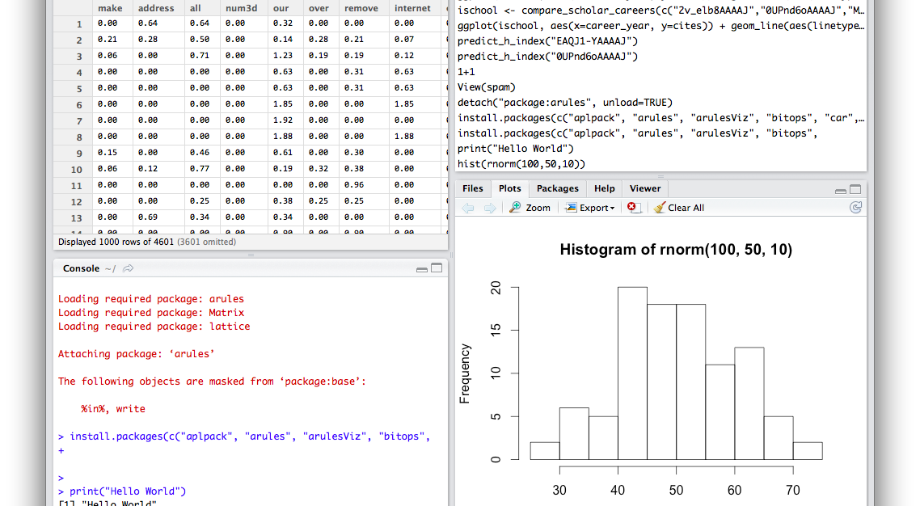
R-Studio

Slide 8
Command Line? Advantages?
In social sciences there has been a lot of talk lately about replication, the necessity of having results that are reproducible
In the world of “big data,” analysts want to produce systems that are transparent, reliable, and that maintain a chain of provenance for each transformation that affects the data
Looking at statistical analysis as a kind of “programming” task (like the old days!) has immense advantages

Slide 9
Look Out! Real Code!
# Read U.S. States shape data from census GIS data set
usShape <- readShapeSpatial("gz_2010_us_040_00_500k.shp")
# Attach the delta CPI data to the states
usShape@data$delta <- stateCPIdelta # Consumer price indices in this table
# This sets up break points for color designations.
# We want 20 gradations of color across all choropleths.
bfloor <- floor(min(usShape@data[,"delta"],na.rm=TRUE)*10)/10
bceil <- (ceiling(max(usShape@data[,"delta"],na.rm=TRUE)*10)/10) + 20
breaks <- seq(bfloor, bceil, 20)
# Attach the color cut points to the shape data
usShape@data$zCat <- cut(usShape@data[,"delta"],breaks,include.lowest=TRUE)
cutpoints <- levels(usShape@data$zCat) # For later use with the legend

Slide 10
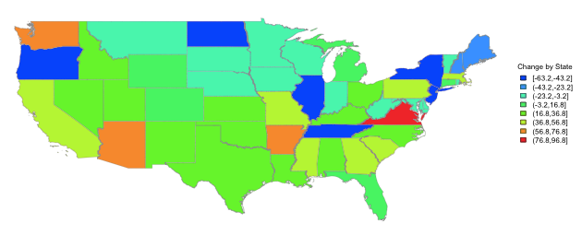
Colorful!

Slide 11
Many Packages - CRAN Task View
ChemPhys Chemometrics and Computational Physics
Econometrics Computational Econometrics
Environmetrics Analysis of Ecological and Environmental Data
ExperimentalDesign Design of Experiments (DoE) & Analysis of Experimental Data
Finance Empirical Finance
Genetics Statistical Genetics
Graphics Graphic Displays & Dynamic Graphics & Graphic Devices & Visualization
HighPerformanceComputing High-Performance and Parallel Computing with R
MachineLearning Machine Learning & Statistical Learning
MedicalImaging Medical Image Analysis
MetaAnalysis Meta-Analysis
Multivariate Multivariate Statistics
NaturalLanguageProcessing Natural Language Processing
Optimization Optimization and Mathematical Programming
Pharmacokinetics Analysis of Pharmacokinetic Data
Phylogenetics Phylogenetics, Especially Comparative Methods
Psychometrics Psychometric Models and Methods
ReproducibleResearch Reproducible Research
SocialSciences Statistics for the Social Sciences
Spatial Analysis of Spatial Data
Survival Survival Analysis
TimeSeries Time Series Analysis
WebTechnologies Web Technologies and Services

Slide 12
Why R?
Free and open source
Huge community of users, enormous repository of working code examples, many sources of online expertise/support
Dizzying array of add-on packages for almost any imaginable data application
Encourages good data practice: coding a reproducible chain of data transformations

Slide 13
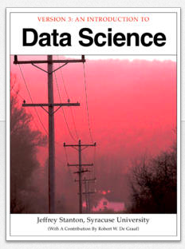
Jsresearch.net

